Slide 1
Optimization of Freezer allocation and Assortment Process for Company XYZ
Team MilkMan

Slide 2
Business Problem
Company XYZ sells beverages and Ice Cream and it has a reach of under 1000 stores
Stores specialize in selling as bulk items or impulse items or as a mix of both.
Stores needs freezers to allocate items.
Freezers comes in different volumes and power consumption
Our Business goal is to optimally allocate freezers to stores as the reach grows so as we would improve sales against the cost invested in freezers.

Slide 3
BUT..
Since our client has just under 1000 stores with them, doing this task manually is a resource consuming task.
For this reason our team of Data Scientists are introducing a new analytical solution which would improve Company XYZ sales against the cost invested in freezers with the help of techniques in statistics and Machine Learning.

Slide 4
METRICS..
Specific freezer which goes to a particular store outlet depends on
Outlet Size
Outlet Space Availability
Outlet Sales
Outlet Location
Based on these we will be grouping stores into 6 categories. And the same freezer type will be most suitable for all the stores among each category.

Slide 5
Analytical Solution
With the help of advanced Machine Learning Algorithm Called K-Means, we could categorize the outlet stores into 6 groups that would best suit similar freezer types.
For each group we have performed an advanced analytics calculation to find the best suit freezer type for that particular group.

Slide 6
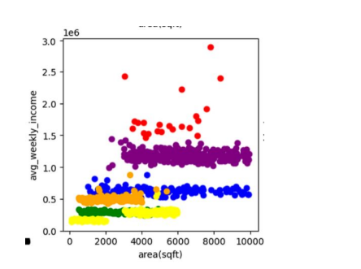
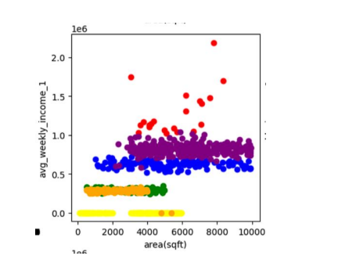
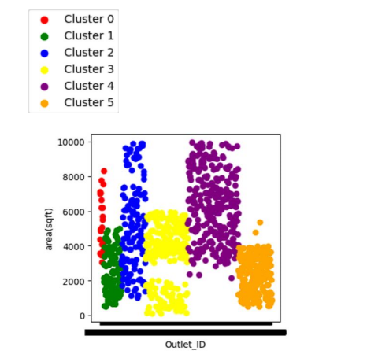
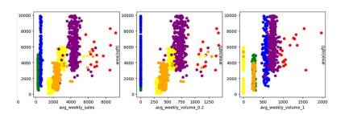
Analytical Solution

Slide 7
Analytical Solution
In the best categorization outlets with higher sales and volumes always use high-capacity freezers like IceTech while other stores use more balanced freezers like IceBlast. These values were optimized for total weekly income and volume sold.

Slide 8
Optimize product assortment within the allocated freezer type.

Slide 9
Business Problem
Company XYZ have wide range of products
They want to optimize their freezer assortment and volume allocation for each product to further maximize their total margin from each store.
The Company XYZ wants optimize their product offerings while maintaining a diversified selection and avoiding stock shortages and guaranteeing that they can fulfill orders in a timely and efficient manner.

Slide 10
Strategies..
Stock the top-selling product of each group in the freezers across all stores belonging to that group.
A maximum limit of 30% of the recommended freezer type's volume for any single product.
Ensure that the total stock distributed is below the current
available stock as product stocks are limited.
We will be offering an analytics solution to optimize the freezer
assortment and volume allocation of their products to maximize their total margin earned
Margin = item selling price - item cost

Slide 11
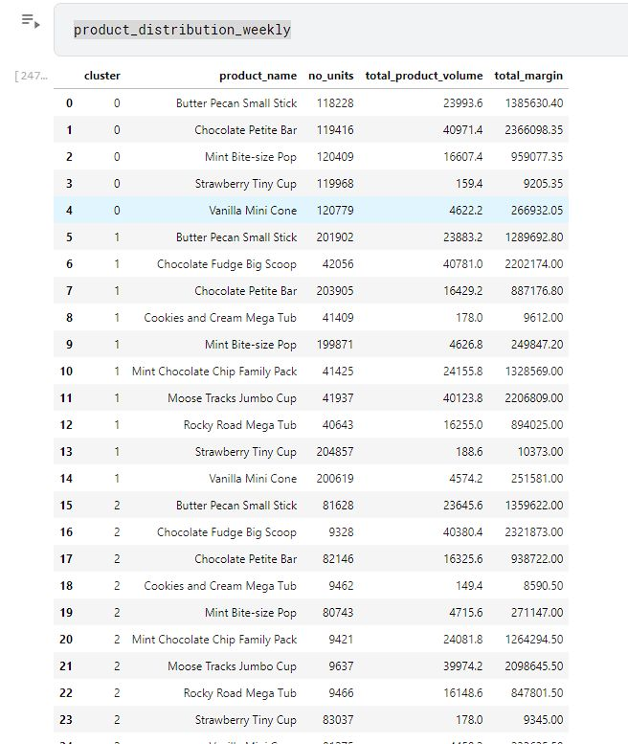
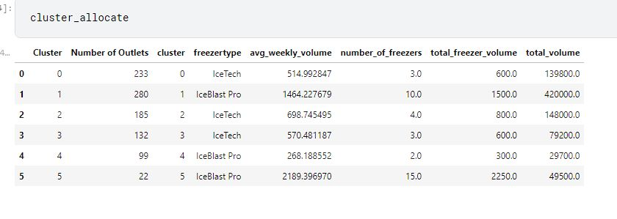
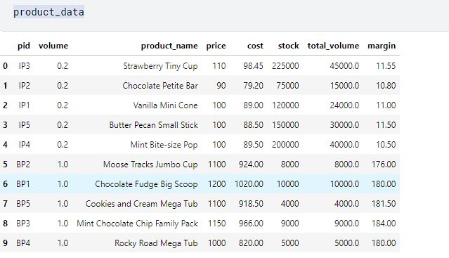
Analytical solution

Slide 12
Conclusion

